Slide 1

D²CAV: A Maneuver-based Driving Dataset for Connected & Automated Vehicle Applications
CAP-5610 Fall 2018: Machine Learning
Final Project
University of Central Florida
By :
Divas Grover (4508120)
Behrad Toghi (4420165)
Rajat Jain (4446187)

Slide 2
Motivation
Connected and automated vehicles (CAVs) have received significant attention during the last decade which, will lead to a hybrid AI-human scenario.
Autonomous and human-driven vehicles will co-exist and interact hence, we need to understand human driving patterns.
In a hybrid AI-human scenario, recognizing a remote human-driven vehicle's intention to perform a maneuver will enable autonomous vehicles to predict and react accordingly
All maneuvers that a vehicle make can be classified as different turns, brakes, merging, exiting etc.
Notes:
Commerical Level 4 autonomous vehicle , Mid 2020
So we need some kind of that to detect human intention for manuevers

Slide 3
Data Collection
We utilized the Ford OpenXC platform and a Garmin Map-62s handheld unit as the logging tools.
Three drivers with different driving styles (aggressive, mild, and conservative) are employed to drive a 2018 Ford Focus with electric assist steering and drive-by-wire throttle actuator.
We conducted ~1000 minutes of urban and highway driving around the UCF campus in the metro Orlando area.
During the field test, a co-pilot was assigned to manually label the maneuvers using a custom-made logging interface.
The logged data fields include engine speed, total fuel consumption since restart, odometer, accelerator pedal position, torque at transmission, steering wheel angle, vehicle speed, and fuel level recorded by the OpenXC logger and latitude, longitude, ground speed, and heading recorded by the Garmin handheld.

Slide 4
Preprocessing
OpenXC has frequency of 10Hz
-10 to +10 seconds to consider for motion w.r.t each maneuver recorded
Similarly for gps data, cubic Interpolation was done to fit OpenXC data
For each instance of maneuver we had 10 features having 210 values
Total number of maneuver recorded are 452 after data cleaning

Slide 5
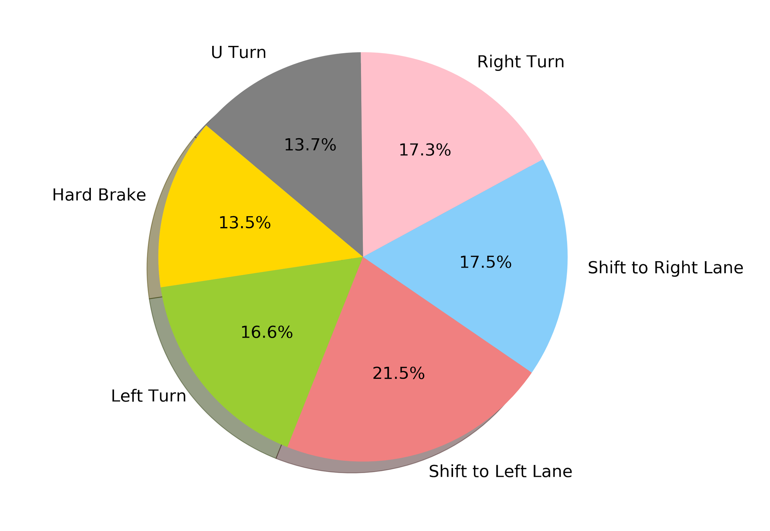
Collected Maneuvers
Hard Brake | 61
Left Turn | 75
Right Turn | 78
U Turn | 62
Shift to Left Lane | 97
Shift to Right Lane | 79

Slide 6
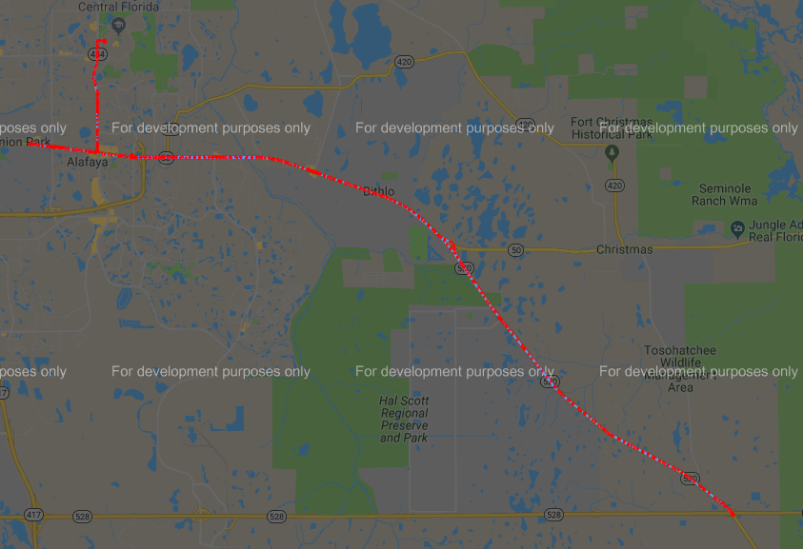
Sample Route

Slide 7
Structure

Slide 8
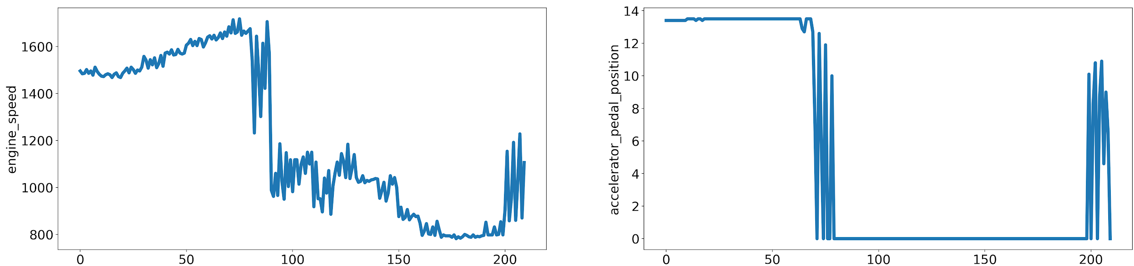
/DATASET
/HARD BRAKE
/LEFT TURN
/RIGHT TURN
/U TURN
/LEFT LANE
/RIGHT LANE
/instance 1
/instance 2
/instance 3
/instance N
instance1.csv
plot_1.png
plot_2.png
engine_speed
vehicle_speed
torque_at_transmission
steering_wheel_angle
accelerator_pedal_position
odometer
fuel_level
fuel_consumed_since_restart
latitude & longitude

Slide 9
Data Insight

Slide 10
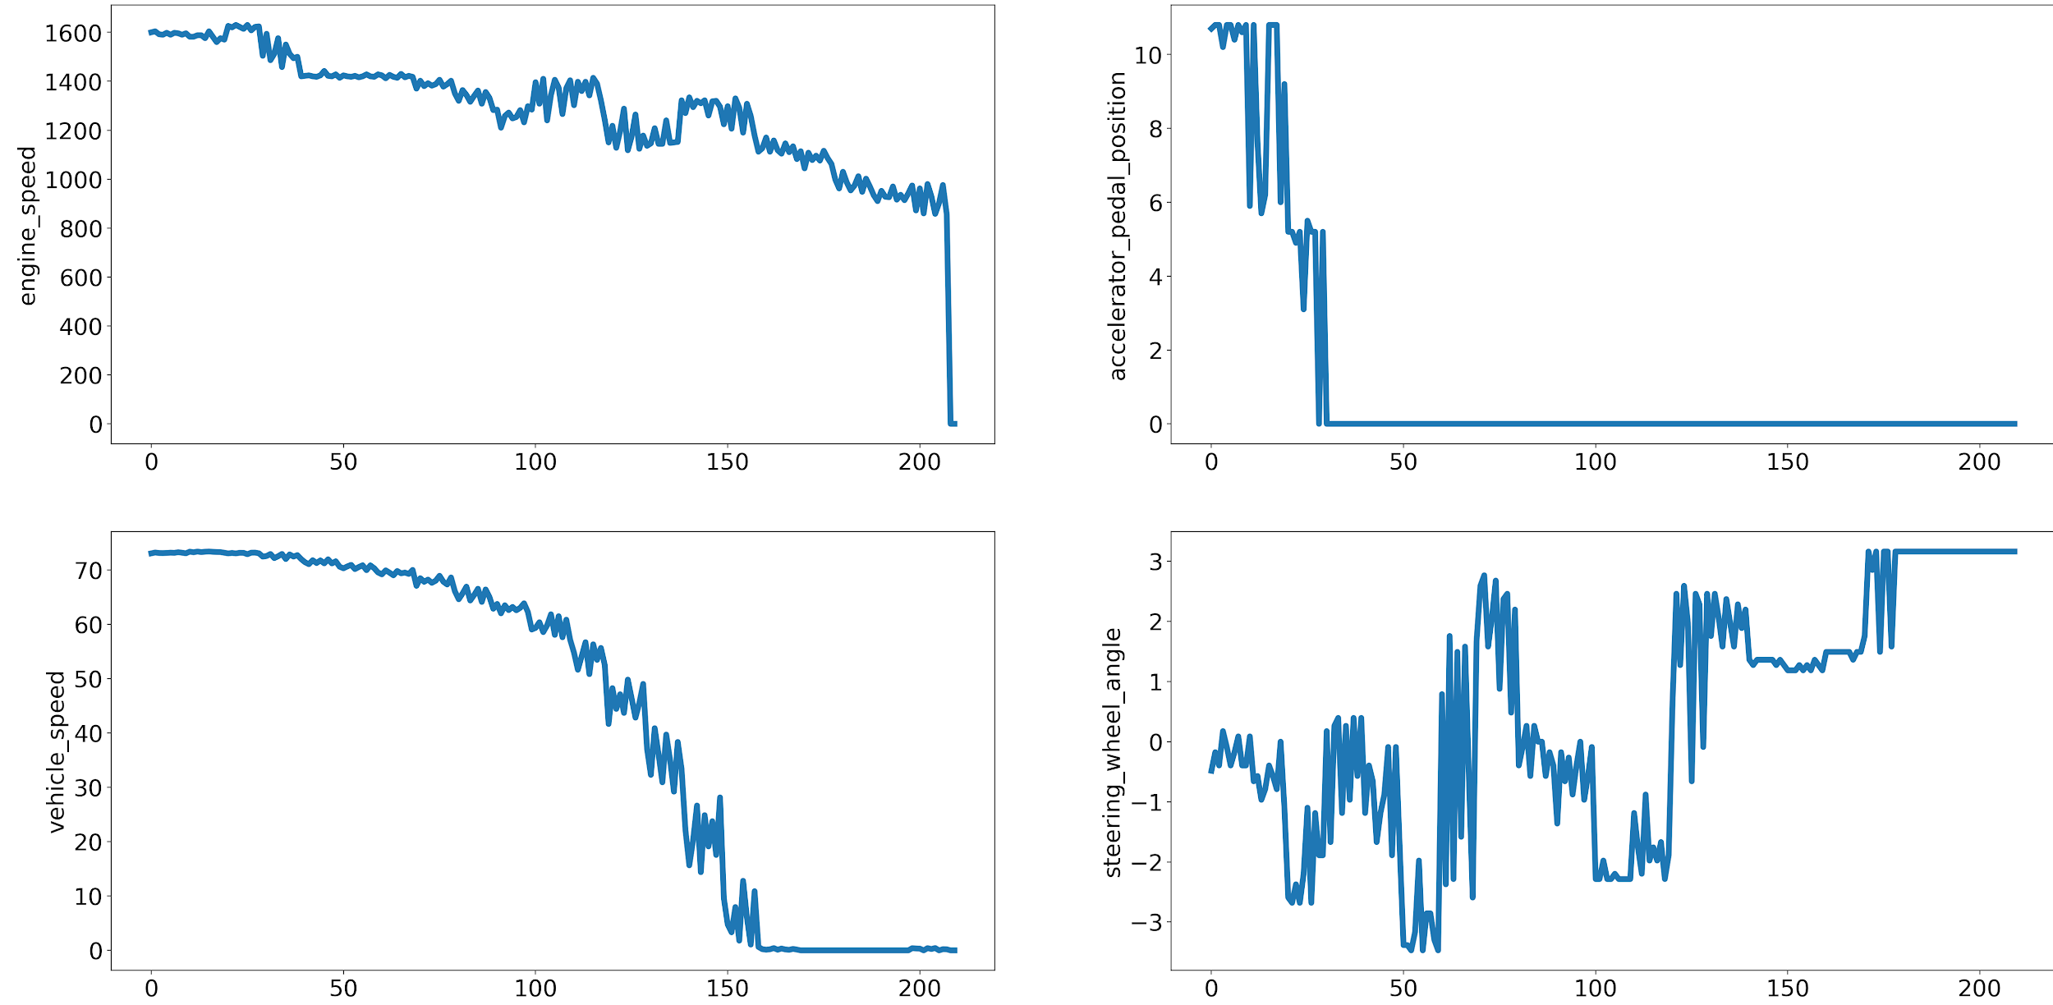
A Hard Brake Maneuver scenario

Slide 11
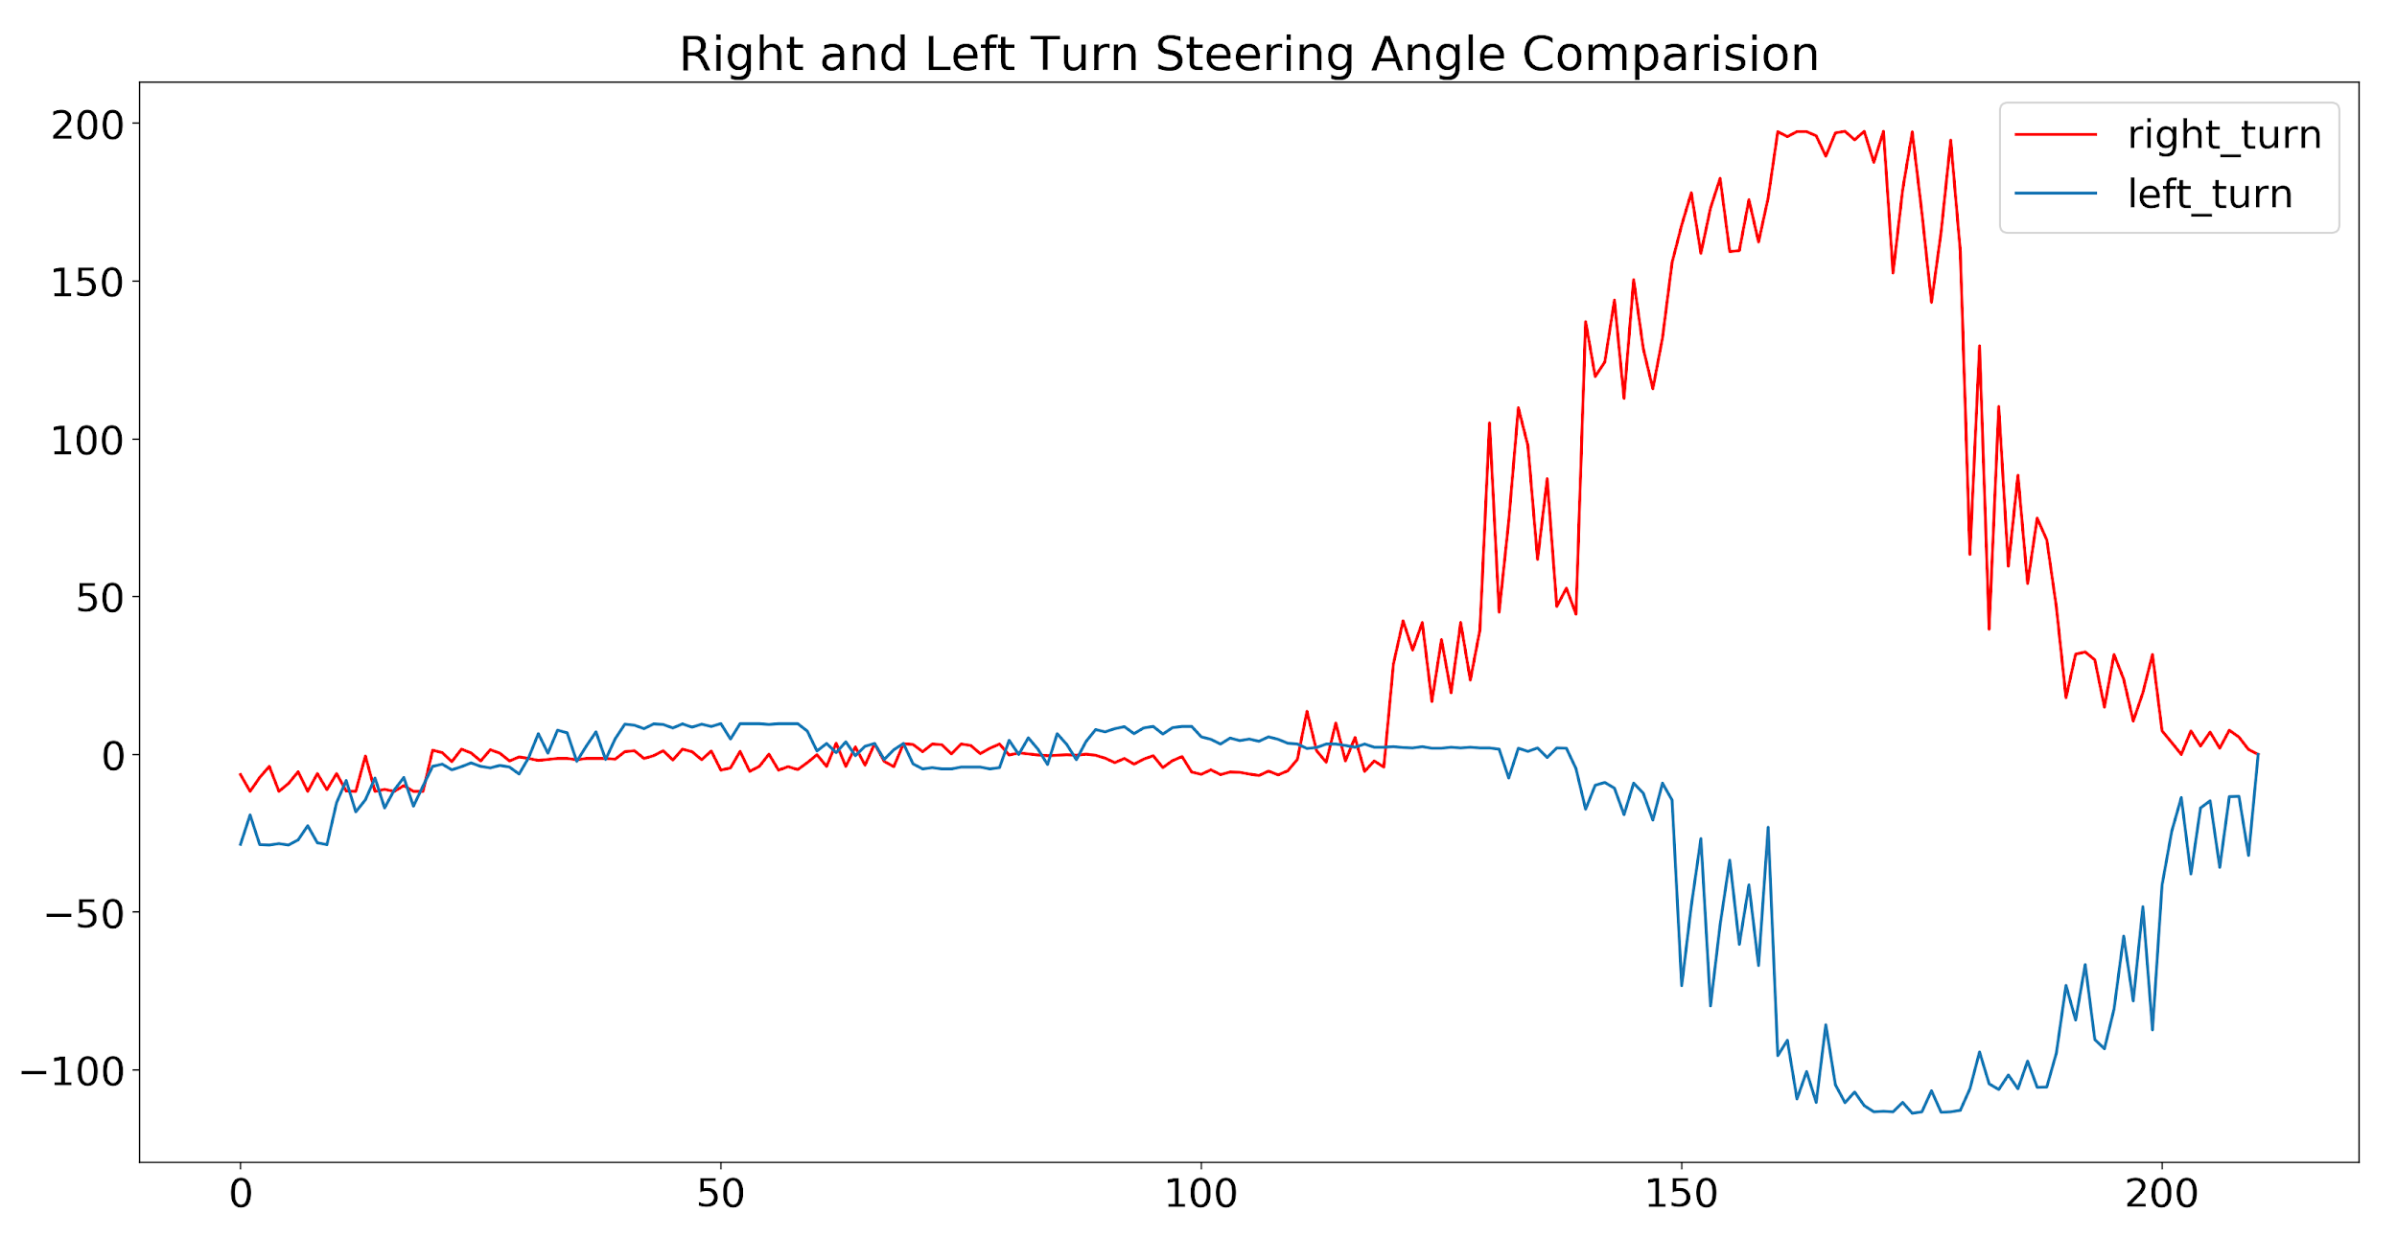
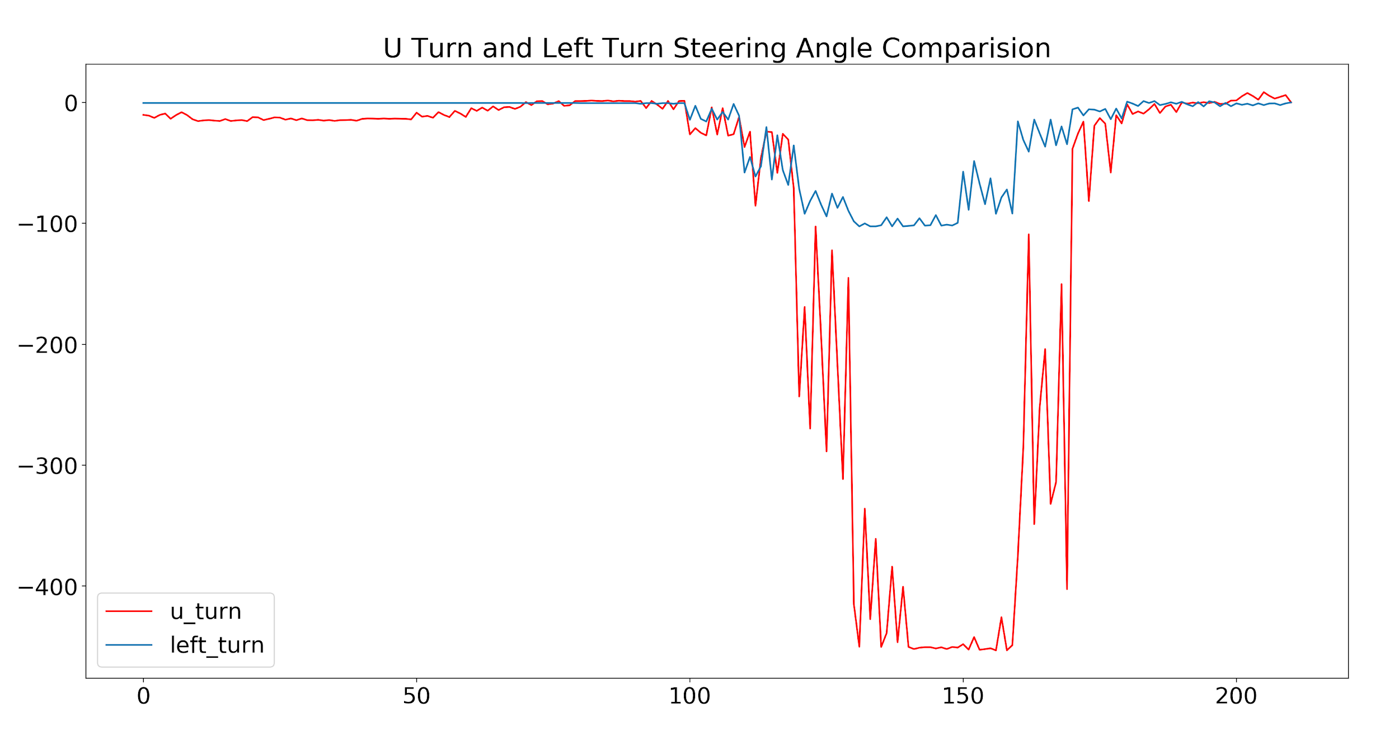

Slide 12
Maneuver Classification
Random Forest Classifier : Creates a set of decision trees from randomly selected subset of training set. It then aggregates the votes from different decision trees to decide the final class of the test object.
Accuracy achieved by Random Forest Classifier is ~89%
Support Vector Machine (SVM) Classifier: is a discriminative classifier formally defined by a separating hyperplane. In other words, given labeled training data, the algorithm outputs an optimal hyperplane which categorizes new examples.
Accuracy achieved by SVM classifier is ~70%

Slide 13
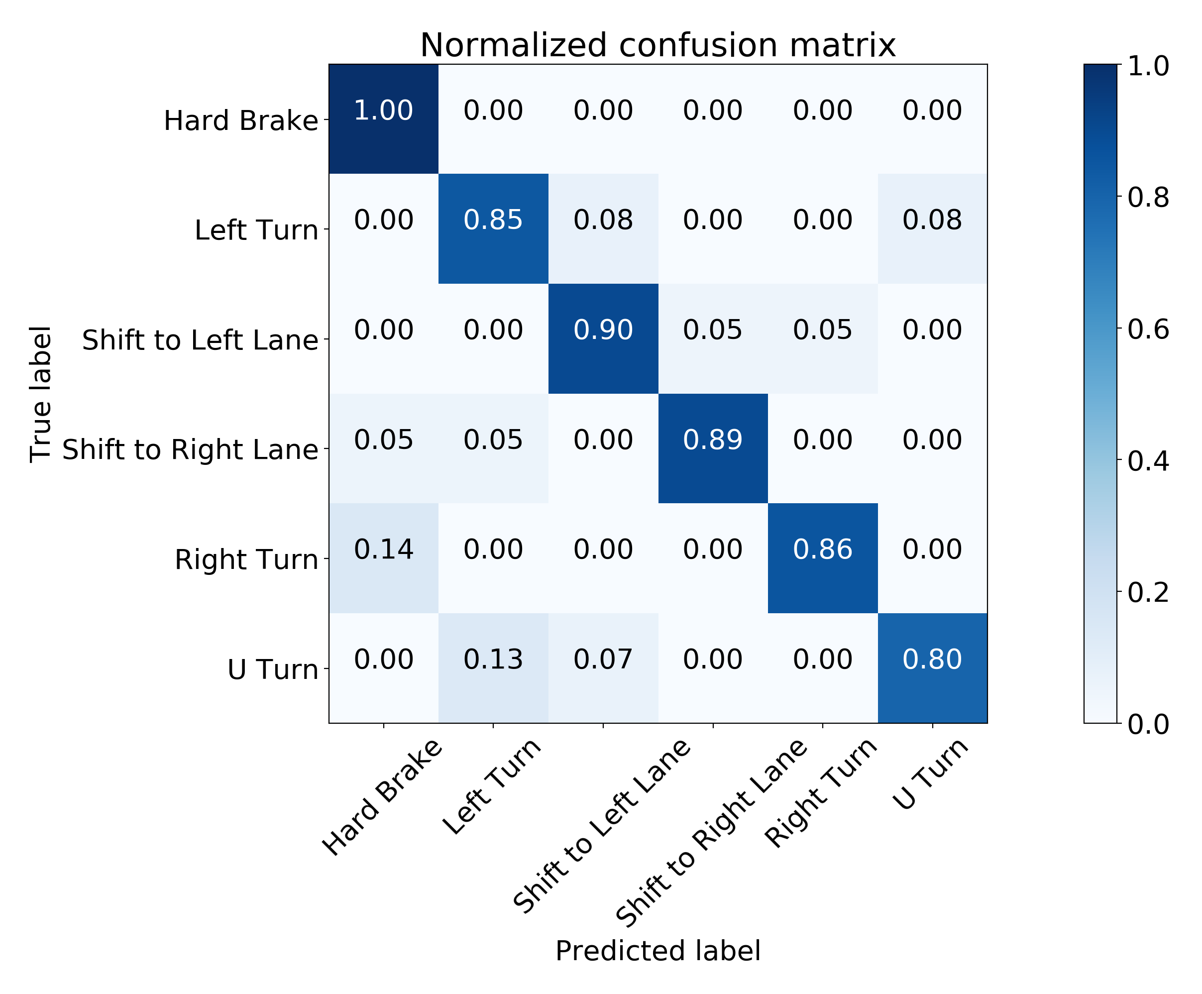
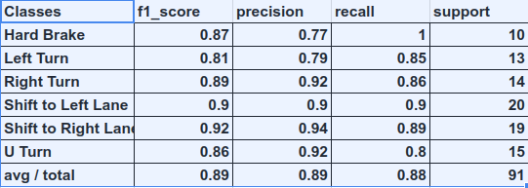
Random Forest Classifier

Slide 14
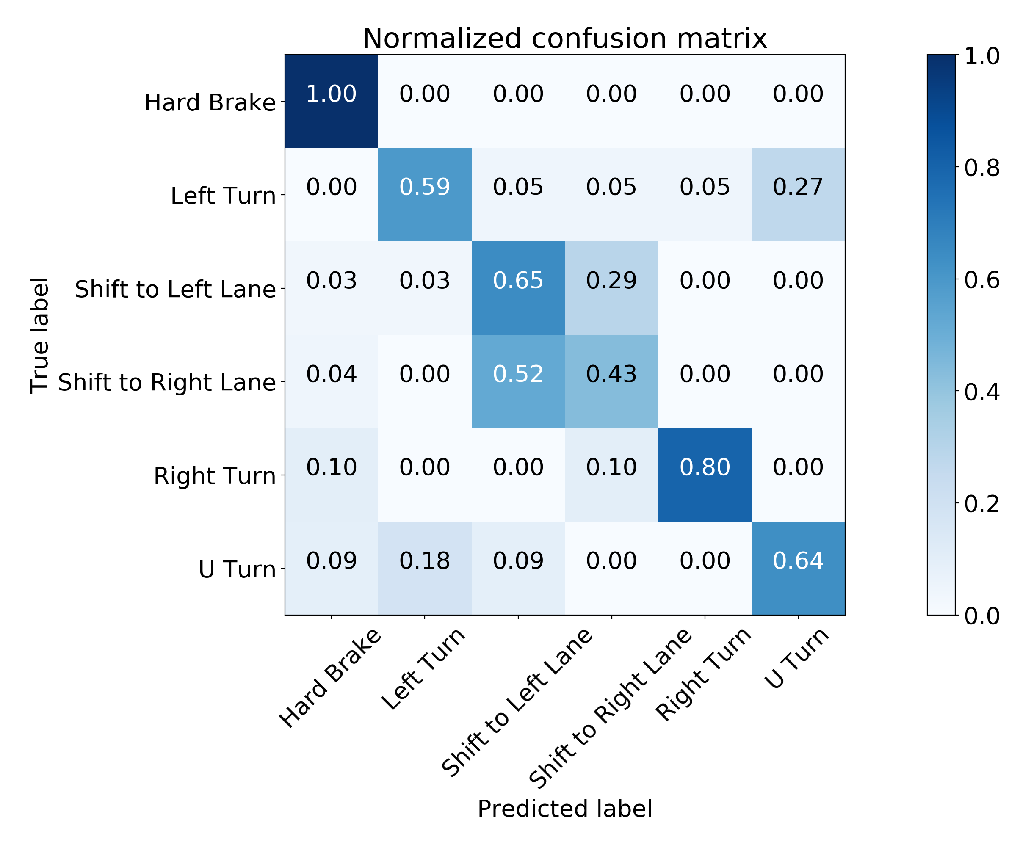
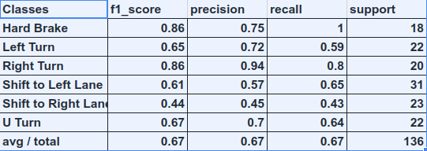
SVM Classifier

Slide 15
Conclusion and Future Work
We have successfully collected dataset for vehicle maneuver’s
Random forest classifier worked best for us
We have planned to make this dataset publicly available as there are not many datasets like this available
Performance can be improved by collecting more data

Slide 16
Thank You

